Slide 1
MSRC분석
김서진

Slide 2
Don’t Let RAID Raid the Lifetime of your SSD Array
Sangwhan Moon, HotStorage13

Slide 3
Protection scheme to improve the reliability of SSD
Error Correcting Code(ECC)
Flash Translation Layer
Log-like Writing and Garbage Collection
Wear-leveling
System Level Protection Scheme
-Parity Protection(RAID5)
: require additional writes -> endurance problem of SSD

Slide 4
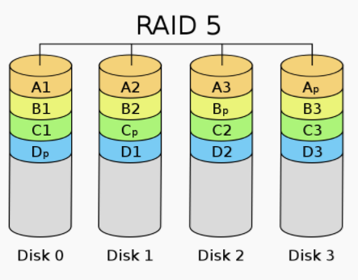
About RAID5
Minimum number of disks: 3
Minimum number of volume : (n-1) x volume per 1 disk
Description: all data and parity are distributed to all disks, but not evenly distributed.
Parity protection
-

Slide 5
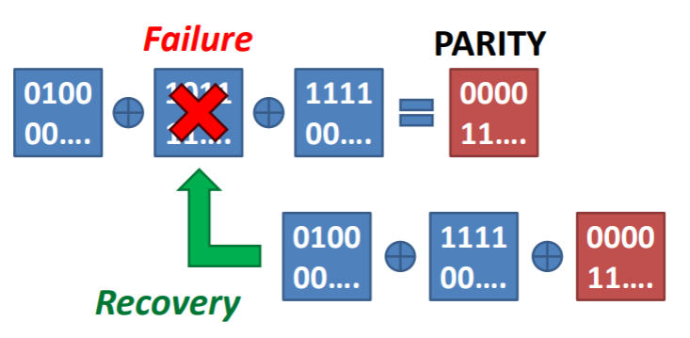
Parity Protection
Def. Protect a device array from a device failure
- Protect each page group from a page error
Parity = XOR of ALL data
Parity update results in additional writes

Slide 6
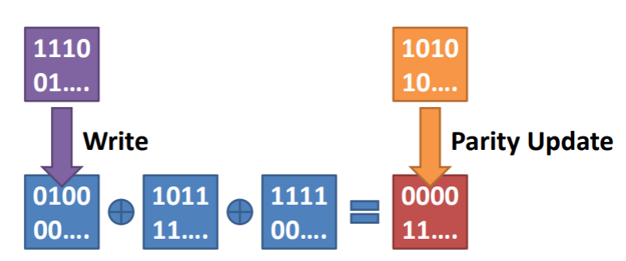
Parity protection
Parity update -> additional write
For a small write , Write amplification:2
For a large write, write amplification: N/(N-1)
(N is the number of SSDs in RAID)

Slide 7
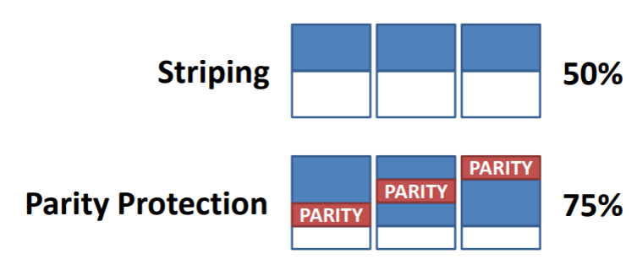
Parity protection
2. Parity increase space utilization
- less efficient garbage collection
- more write amplification
decrease the lifetime of SSDs

Slide 8
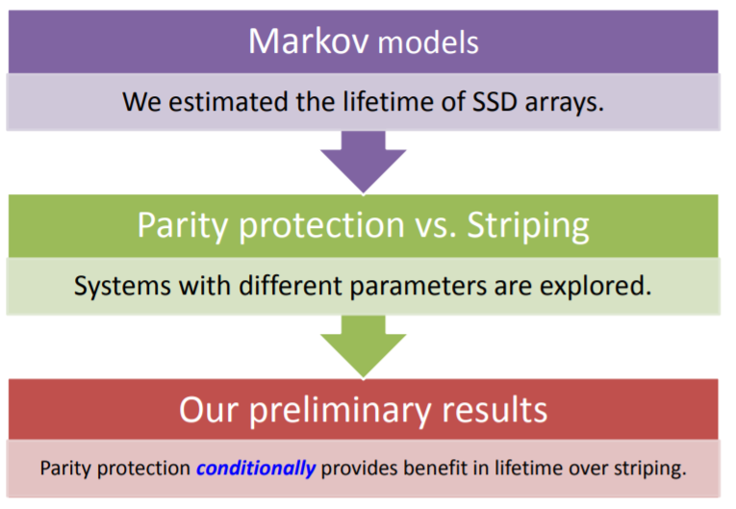
Lifetime model

Slide 9
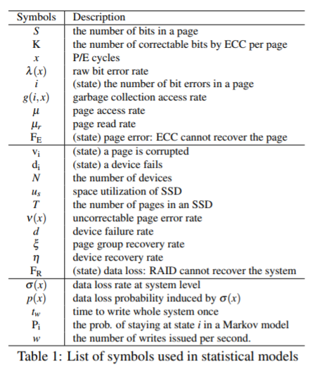
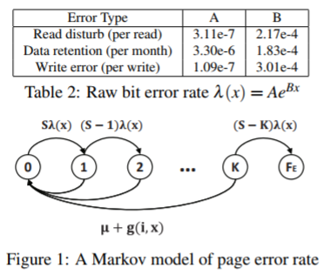
Markov model
Analyze single SSD’s reliability and device level protection
Page Error Rate Model at x write count
Bit errors accumulate until access time
ECC detects / corrects the bit error

Slide 10
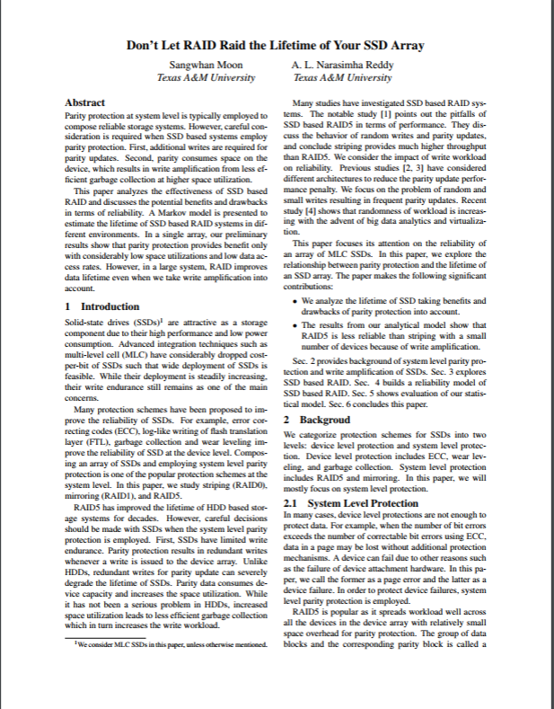
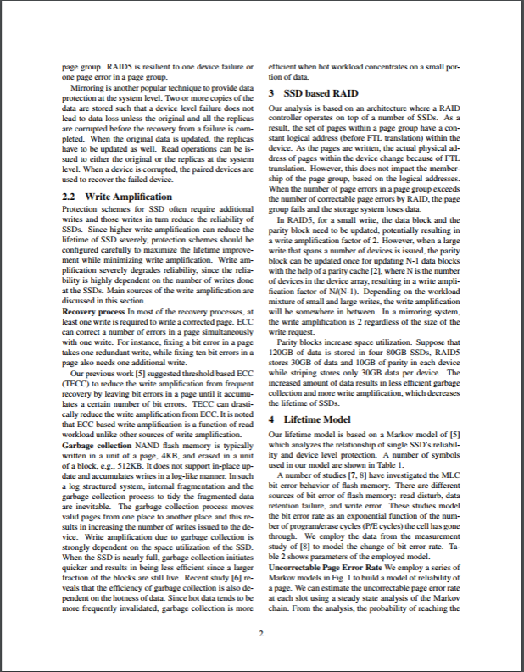
논문 page
1~2p
RAID5 backgrounds

